Slide 1

Serverless Cost Optimizations:
Theory

Slide 2
The Basics

Slide 3

Minimize # of requests/invocations
Minimize duration
Minimize storage
Notes:
ESBuild or Webpack can reduce size by +80%
Expire DDB items via TTL

Slide 4
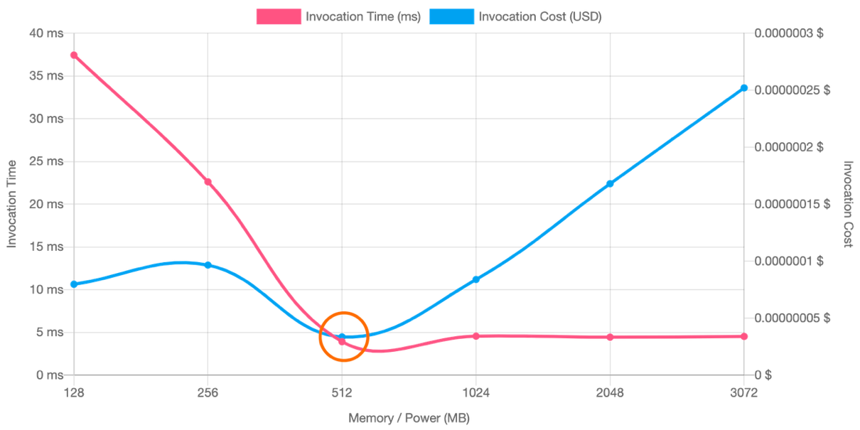
Original
Memory: 128MB
Duration: 36ms
Option A (👍):
Memory: 512MB
Duration: 4ms
Savings: +36%
Speed: +88%
Option B (👎):
Memory: 3072MB
Duration: 4.5ms
Savings: -257%
Speed: +87%
Original
Option A
Option B
https://aws.amazon.com/blogs/compute/optimizing-your-aws-lambda-costs-part-1/

Slide 5
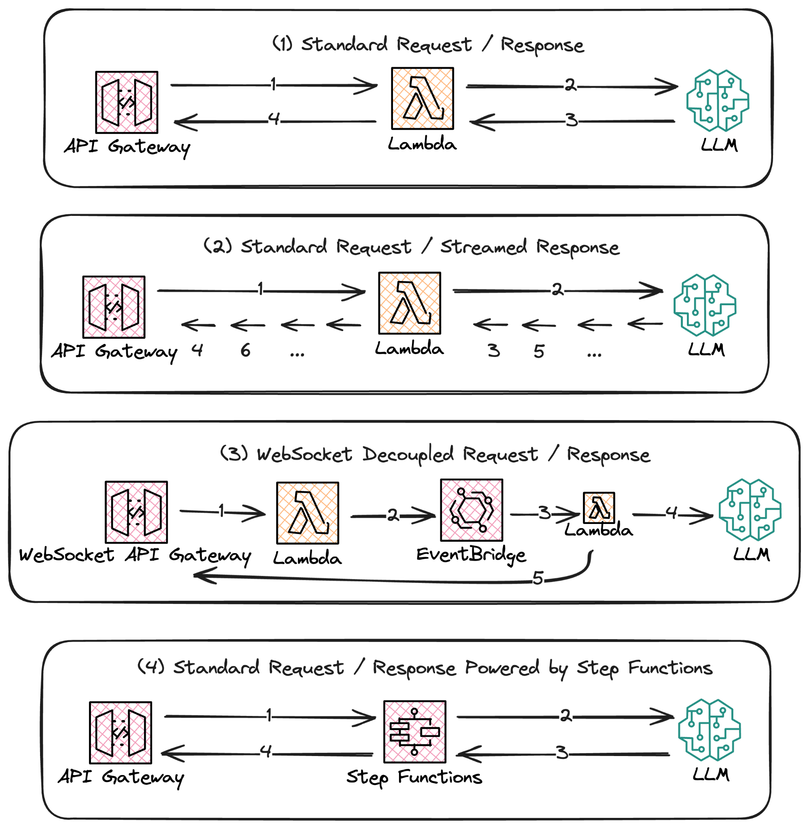
LLM Access
Patterns
Notes:
ESBuild or Webpack can reduce size by +80%
Expire DDB items via TTL

Slide 6
Serverless Cost Optimizations:
An Example

Slide 7
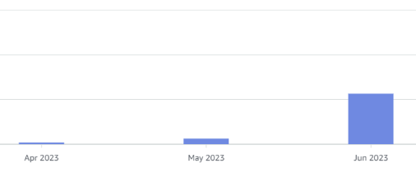
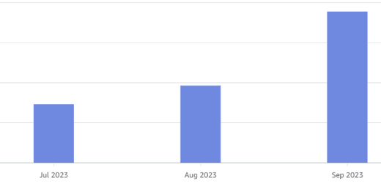
The 100x Lambda
How did this start?
Looking at the AWS Cost Dashboard we realized there was an 100x increase in the Lambda costs in only 6 months

Slide 8
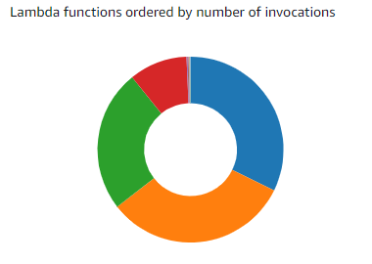
The 100x Lambda
A single lambda at fault
Using CloudWatch Metrics Dashboards we confirmed the red slice was our costly lambda and only accounted for 10% of invocations

Slide 9
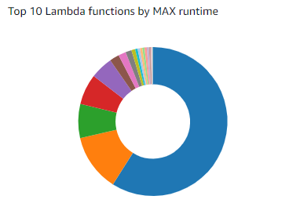
The 100x Lambda
Max execution time is long ⏰
Here we can see the same Lambda (now shown in BLUE) is by far the one that has the longest running request. But what is causing the long running times?

Slide 10
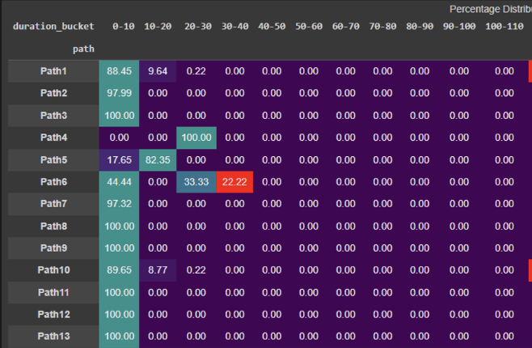
The 100x Lambda
Analyzing Lambda Durations
We categorized the request / response times by path e.g. Path 1, Path 2, etc with a duration between 0-10, 10-20, etc
It’s interesting to see that there’s a gap between ~40s and ~110s duration time. That suggests that there’s something wrong with those requests that are potentially causing it to hang.

Slide 11
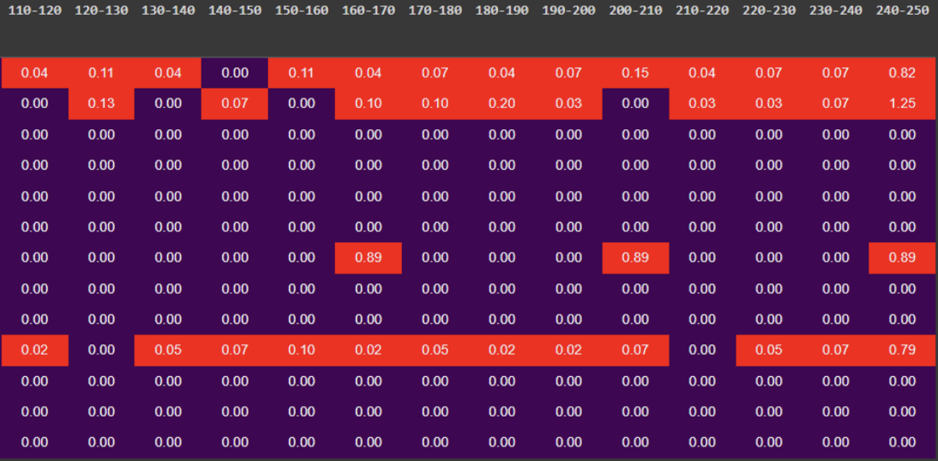
The 100x Lambda
Anything highlighted in red is longer than 30s. We found out that a small percentage of requests in only a few paths were taking a long time to respond.

Slide 12
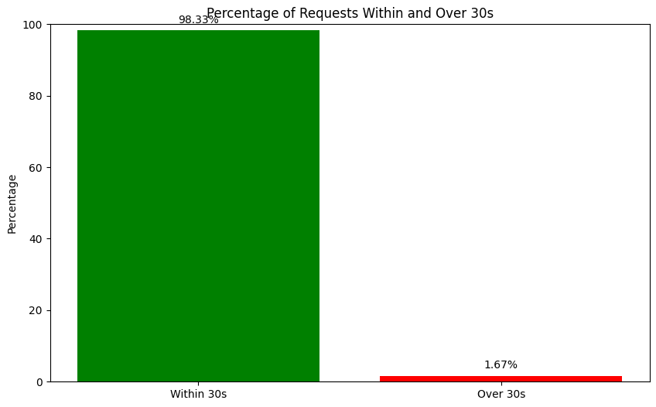
The 100x Lambda
Percentage of Requests
Only 1.67% of requests took longer than 30s.
Waste Analysis
$10k/mo in waste
< 2% responsible for 1/3rd cost

Slide 13
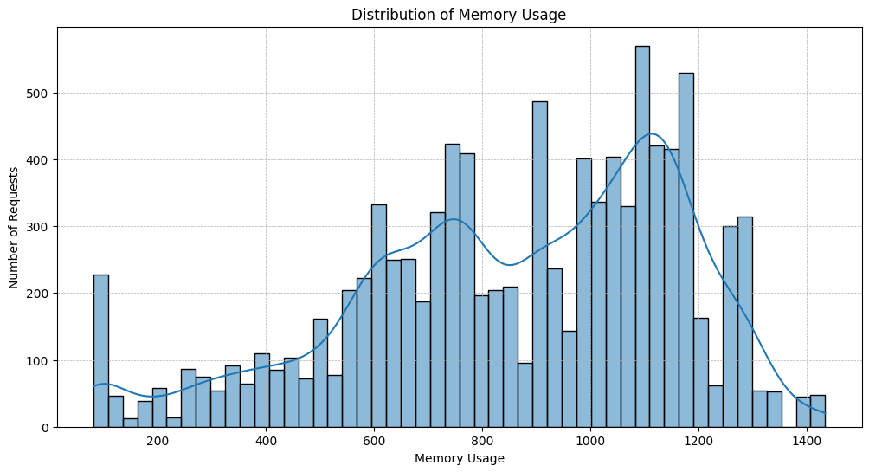
The 100x Lambda
Lambda was set to 4096 MB which was very over provisioned.
An adjustment of memory to 1536mb would be a good first step, and it’s 62.5% cheaper or $6k in savings off memory alone.
Reducing timeout + memory, saved roughly $15k/mo.

Slide 14
The 100x Lambda: Recap
Looking at the AWS Cost Dashboard we realized there was an 100x increase in the Lambda costs in only 6 months
Upon further investigation it became clear that the increase in cost was driven mostly by a single Lambda
Analyzing the Lambda Logs we realized that this particular Lambda had a few requests taking up to 4 minutes to respond

Slide 15
The 100x Lambda: Recap
Long requests were consuming a lot of Lambda Concurrency up to the Max Concurrency Level, causing new invocations to throttle on every service on the same account.
Realized these requests were hanging and after 120 seconds even if a valid response comes back it would no longer be useful since the connection was already closed by the CDN provider.
Thus it was decided we should reduce the Lambda Max Timeout to reduce unnecessary costs and throttling. Which led to $15k/mo in savings!

Slide 16
That’s it folks!
Thank you!

